Slide 1

Vehicle Loan Default Prediction
Team Members:
Shehzada Alam
Shreyas Wankhede
Sagar Bhutada
Sameer Pophali
Urvi Parekh
Manavi Agarwal

Slide 2
Index:
What’s loan Default Prediction? & what’s the problem.
What’s our objective?
Features Description.
Workflow
Data Loading and Cleaning
Data Analysis & Visualization.
Feature Engineering and Selection.
Model Building
Evaluation Metrics

Slide 3
What’s Loan Default Prediction ? & What’s the problem.
Vehicle loan default happens when a customer fails to make the agreed loan payments to the lender or financial services that lent the money for its purchase within particular time period.If a person is default on car loan payments, the lender may take action to repossess the vehicle for selling it.
Default of vehicle loans can badly affect credit scores of borrowers.
Financial institutions incur significant losses due to the default of vehicle loans.
Loan Default Prediction ensures that whether clients are capable of repayment or not and important determinants can be identified which can be further used for minimising the default rates.
Sources:
https://datahack.analyticsvidhya.com/contest/ltfs-datascience-finhack-an-online-hackathon/

Slide 4
What’s our objective?
End-user: Financial institution
Objective: The objective of this project is to predict the probability of loanee or borrower defaulting on a vehicle loan in the first EMI (Equated Monthly Instalments) on the due date.
Dataset: The Vehicle Loan Default Prediction dataset includes following features:
Dependent feature: loan_default
Independent features: disbursed_amount, asset_cost, ltv, PERFORM_CNS.SCORE etc.
The dataset contains 345550 rows and 41 features.

Slide 5
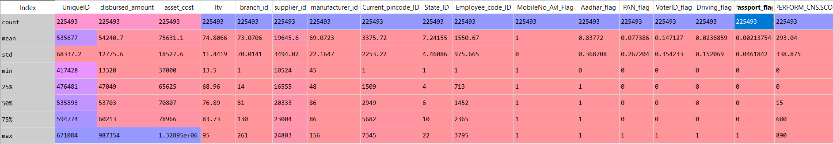
Features Description.

Slide 6
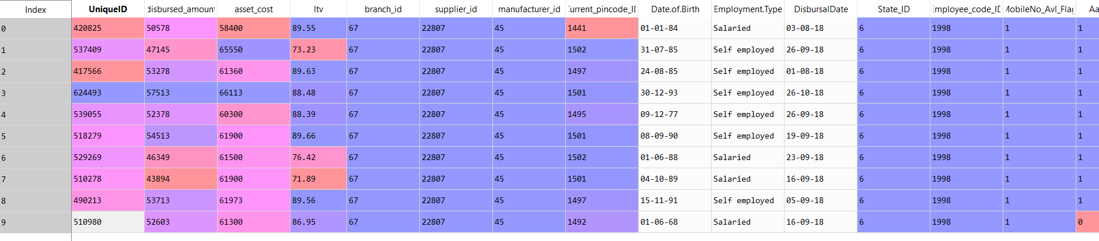
Sample Data

Slide 7
Workflow:
Loading Data
Data Cleaning
EDA
ML Model Building
Feature Selection
Feature Engineering

Slide 8
Data Loading and Cleaning.
Combining training and testing data.
Checking missing values in data.
Imputing Employment.Type missing values with 'Self employed' values.
Checking the outliers using boxplot.
Removing the outliers of 'disbursed_amount' & 'asset_cost' features.

Slide 9
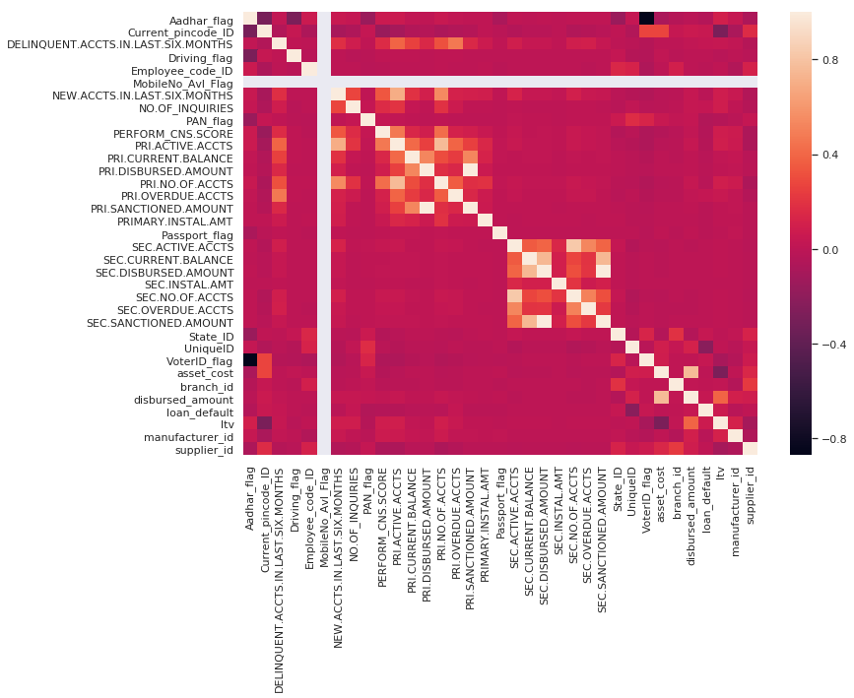
Data Analysis & Visualization

Slide 10
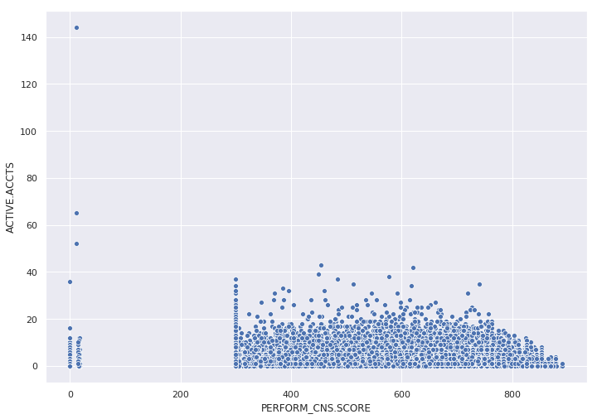
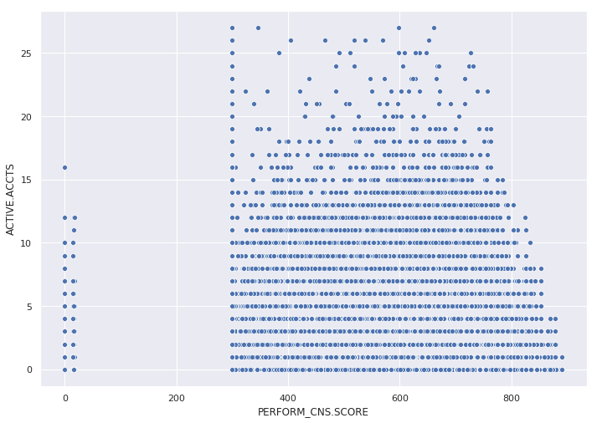
ACTIVE_ACCTS vs PERFORM_CNS_SCORE

Slide 11
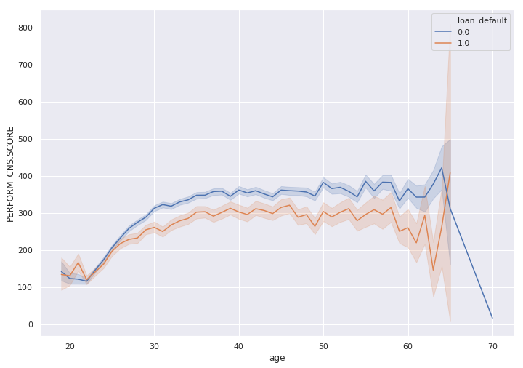
Age vs PERFORM_CNS_SCORE

Slide 12
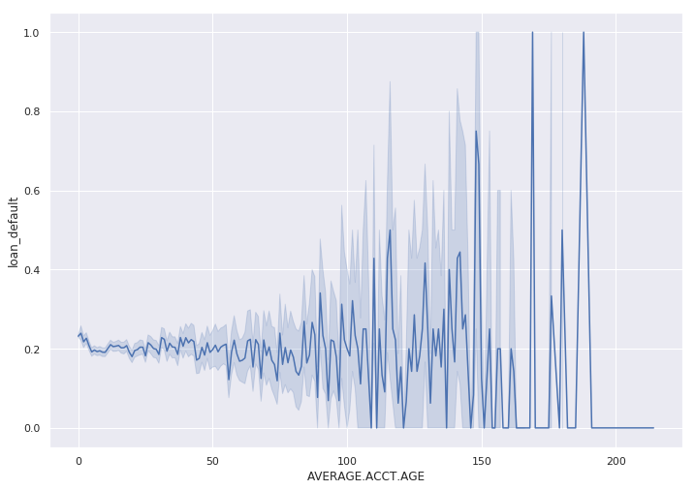
AVERAGE.ACCT.AGE vs loan_default

Slide 13
Feature Enginnering & Feature Selection
Calculating Age column using 'Date.of.Birth'.
Calculating 'AVERAGE.ACCT.AGE' and 'CREDIT.HISTORY.LENGTH' in months.
Creating bins of PERFORM_CNS.SCORE and LTV.
Replacing Values of PERFORM_CNS.SCORE.DESCRIPTION.
Generating New Features like 'ACTIVE.ACCTS','CURRENT.BALANCE' etc.
Dropping irrelevant columns like 'DisbursalDate', 'Current_pincode_ID' ,'NO.OF_INQUIRIES' etc.

Slide 14
Model Selection and Creation
Splitting the data into Train and Test set (70-30).
Classification Models | ROC AUC Score
Random Forest Classifier | 0.54
XGBoost Classifier | 0.60
CatBoost Classifier | 0.6442

Slide 15
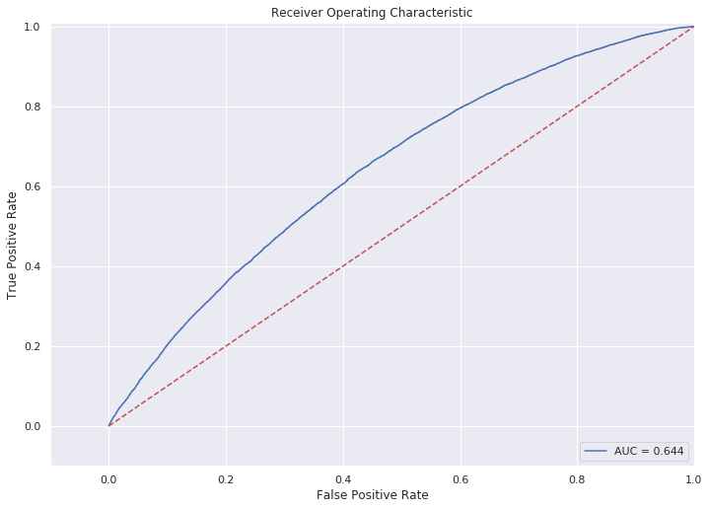
Evaluation Metrics
Area under the ROC curve between the predicted probability and the observed target.

Slide 16
Thank you!

